Slide 2
CEE PRIMITIVA LÓPEZ

Slide 3
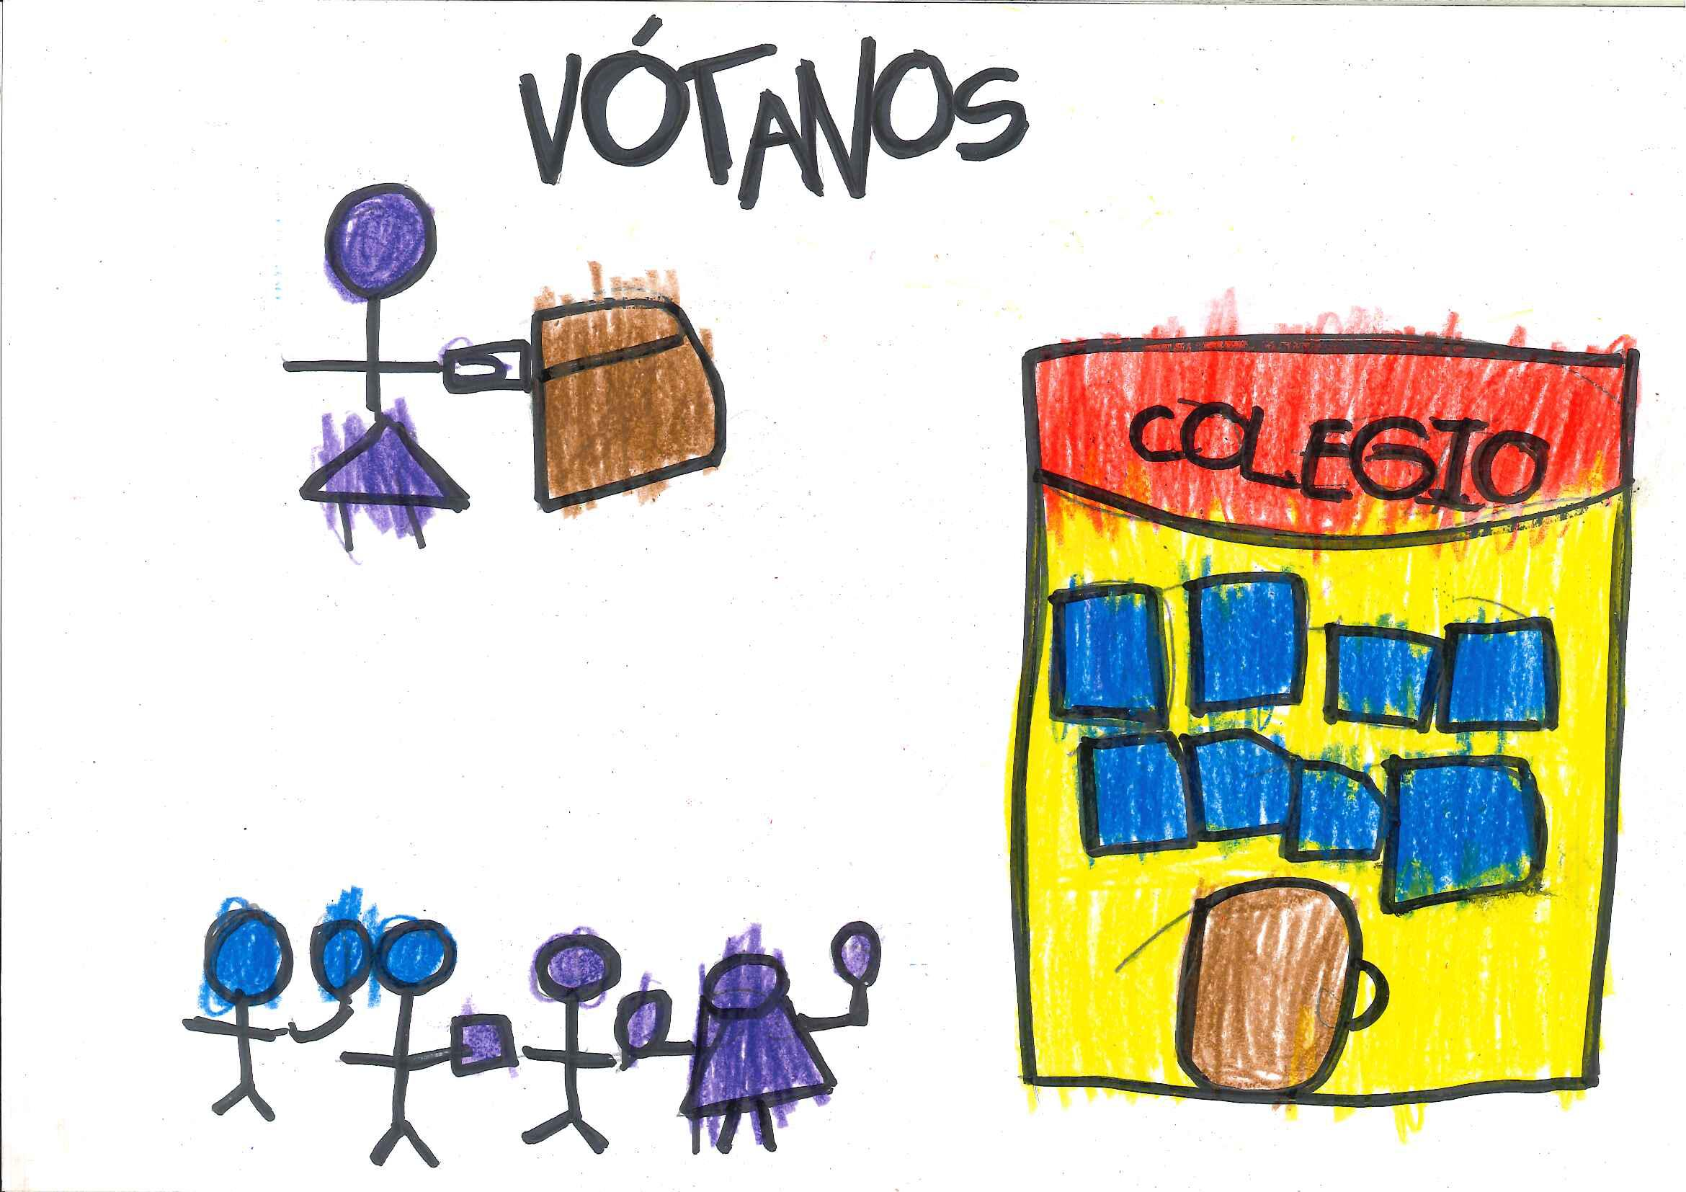
HÉCTOR ALEJANDRO

Slide 4
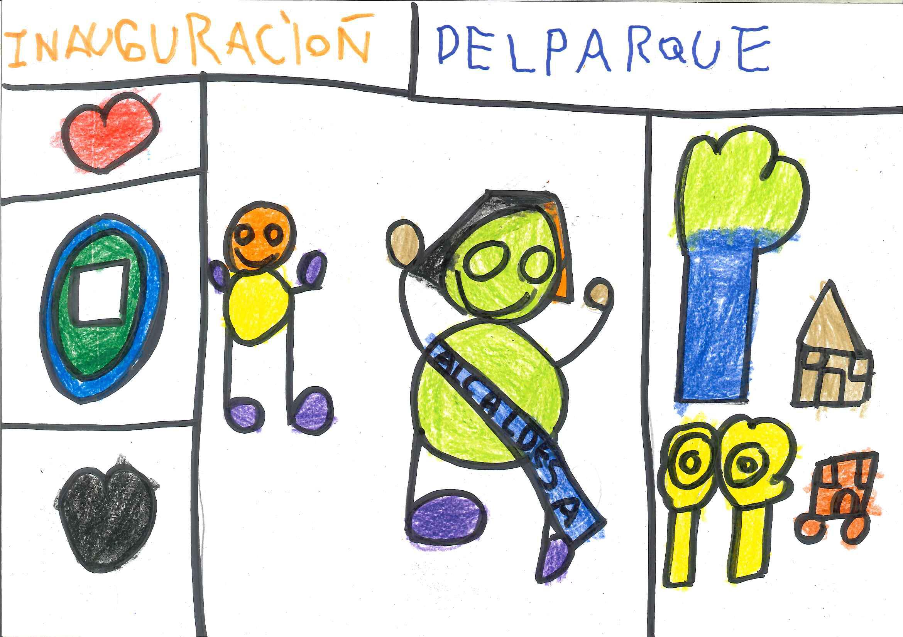
DANIEL

Slide 5
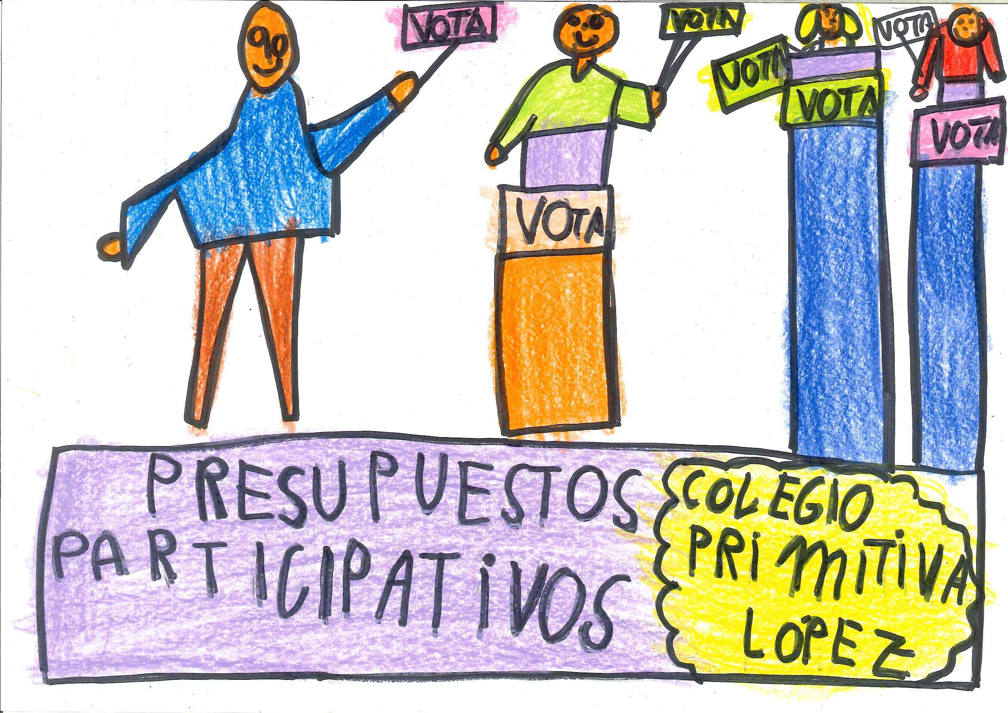
IVÁN

Slide 6
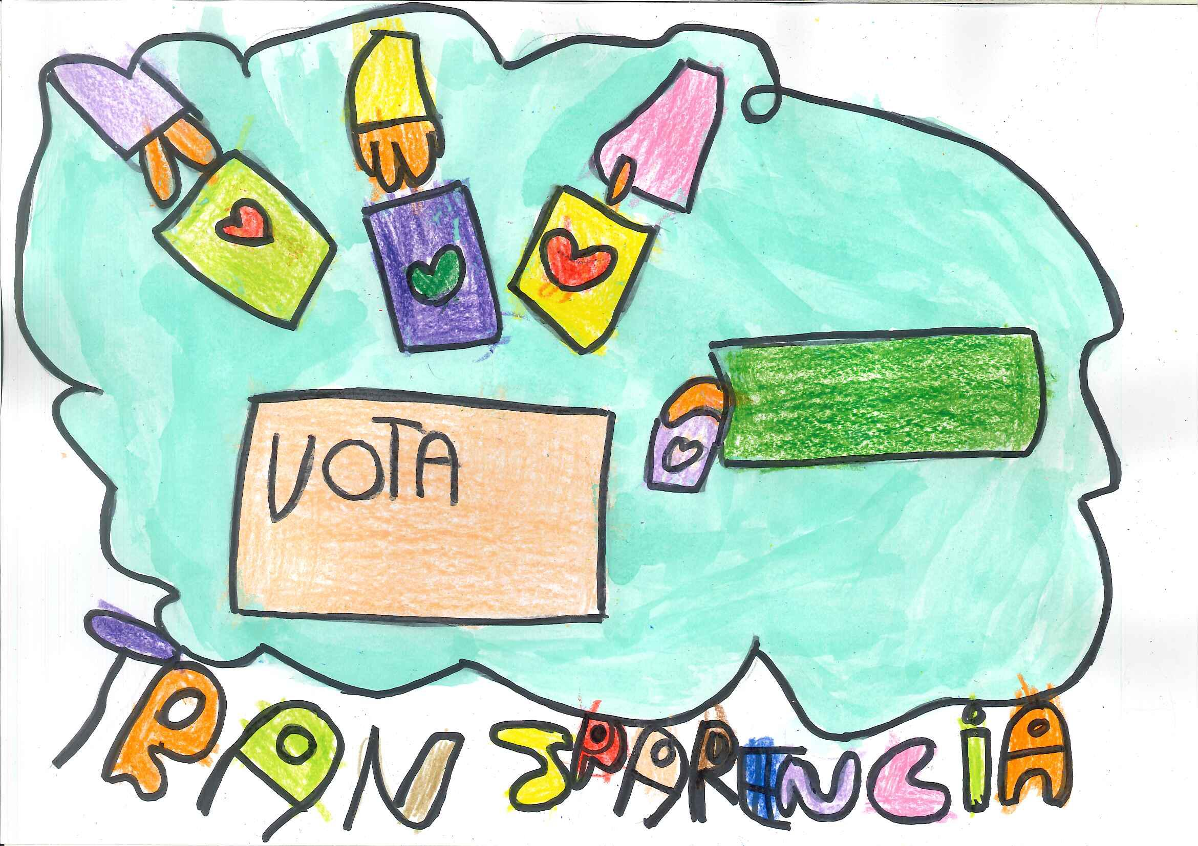
HIBA

Slide 7
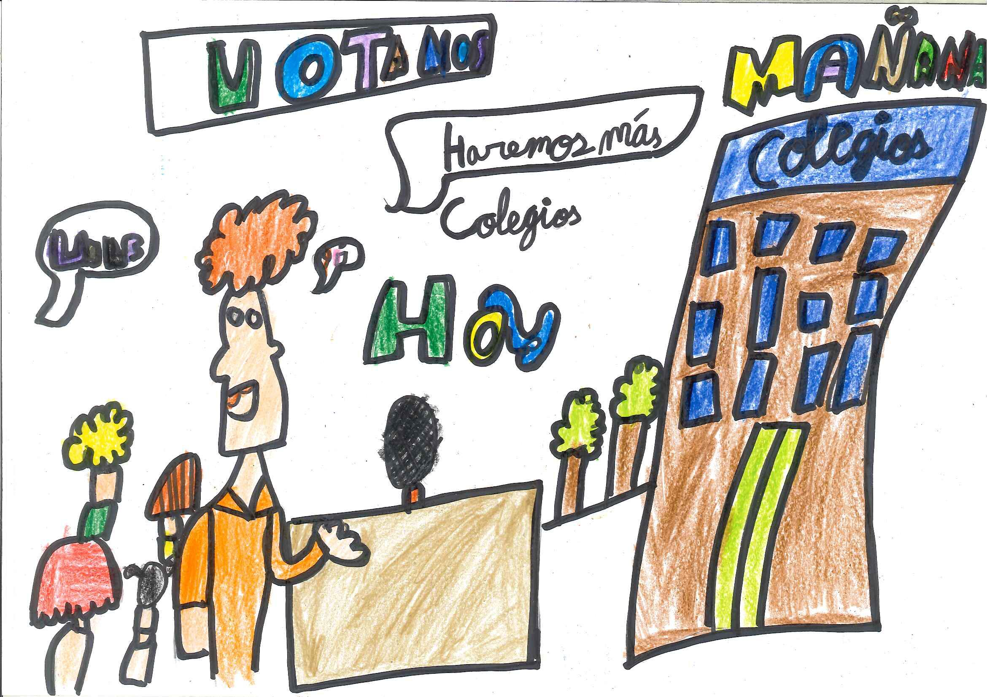
JOSÉ

Slide 8
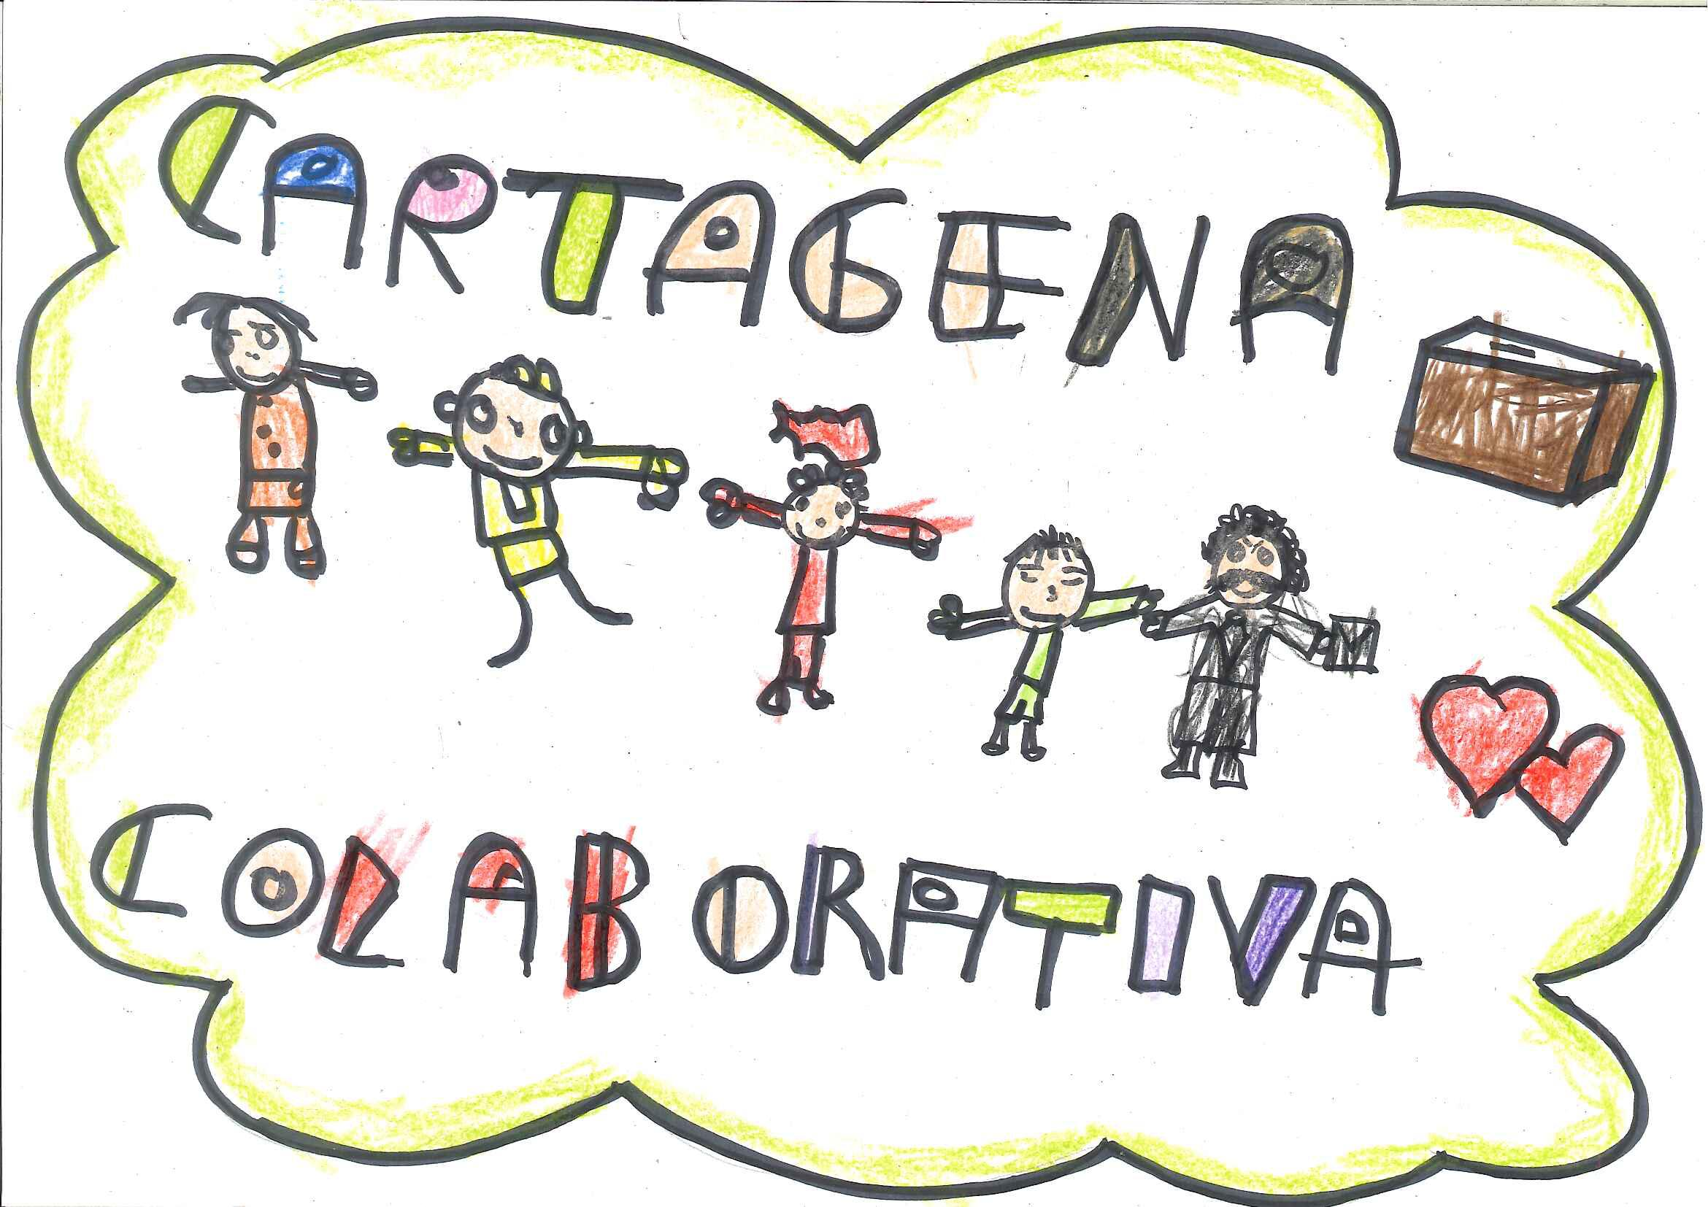
JOSÉ

Slide 9
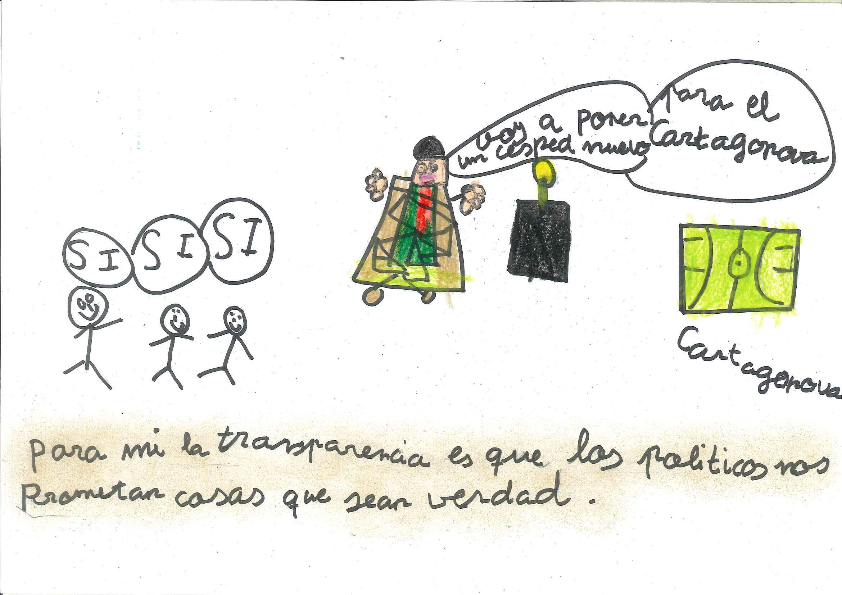
MARÍA DEL MAR

Slide 10
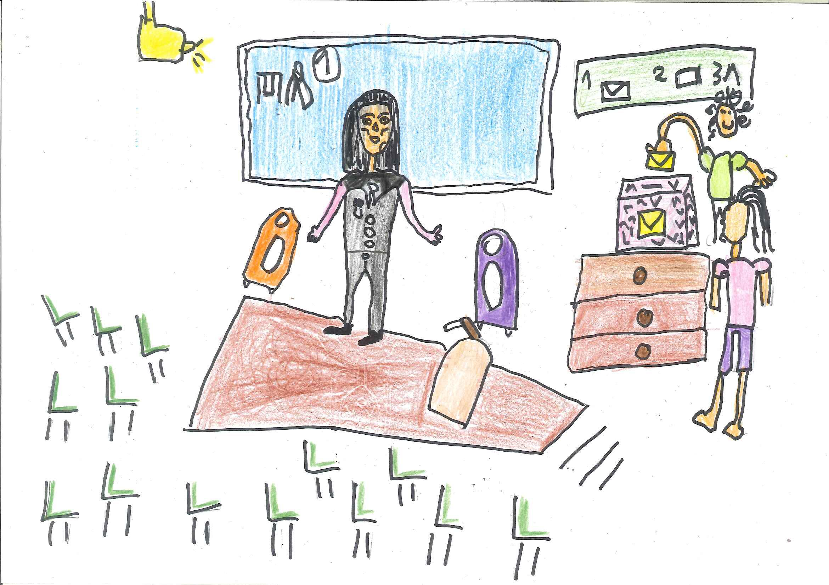
DRISS

Slide 11
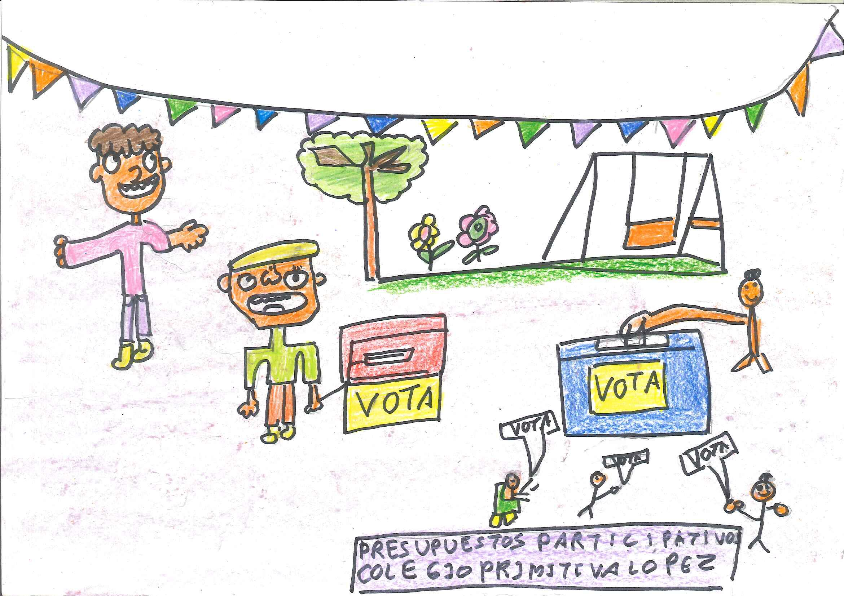
ILYIAS

Slide 12
EEI PIPIRIPAO

Slide 13
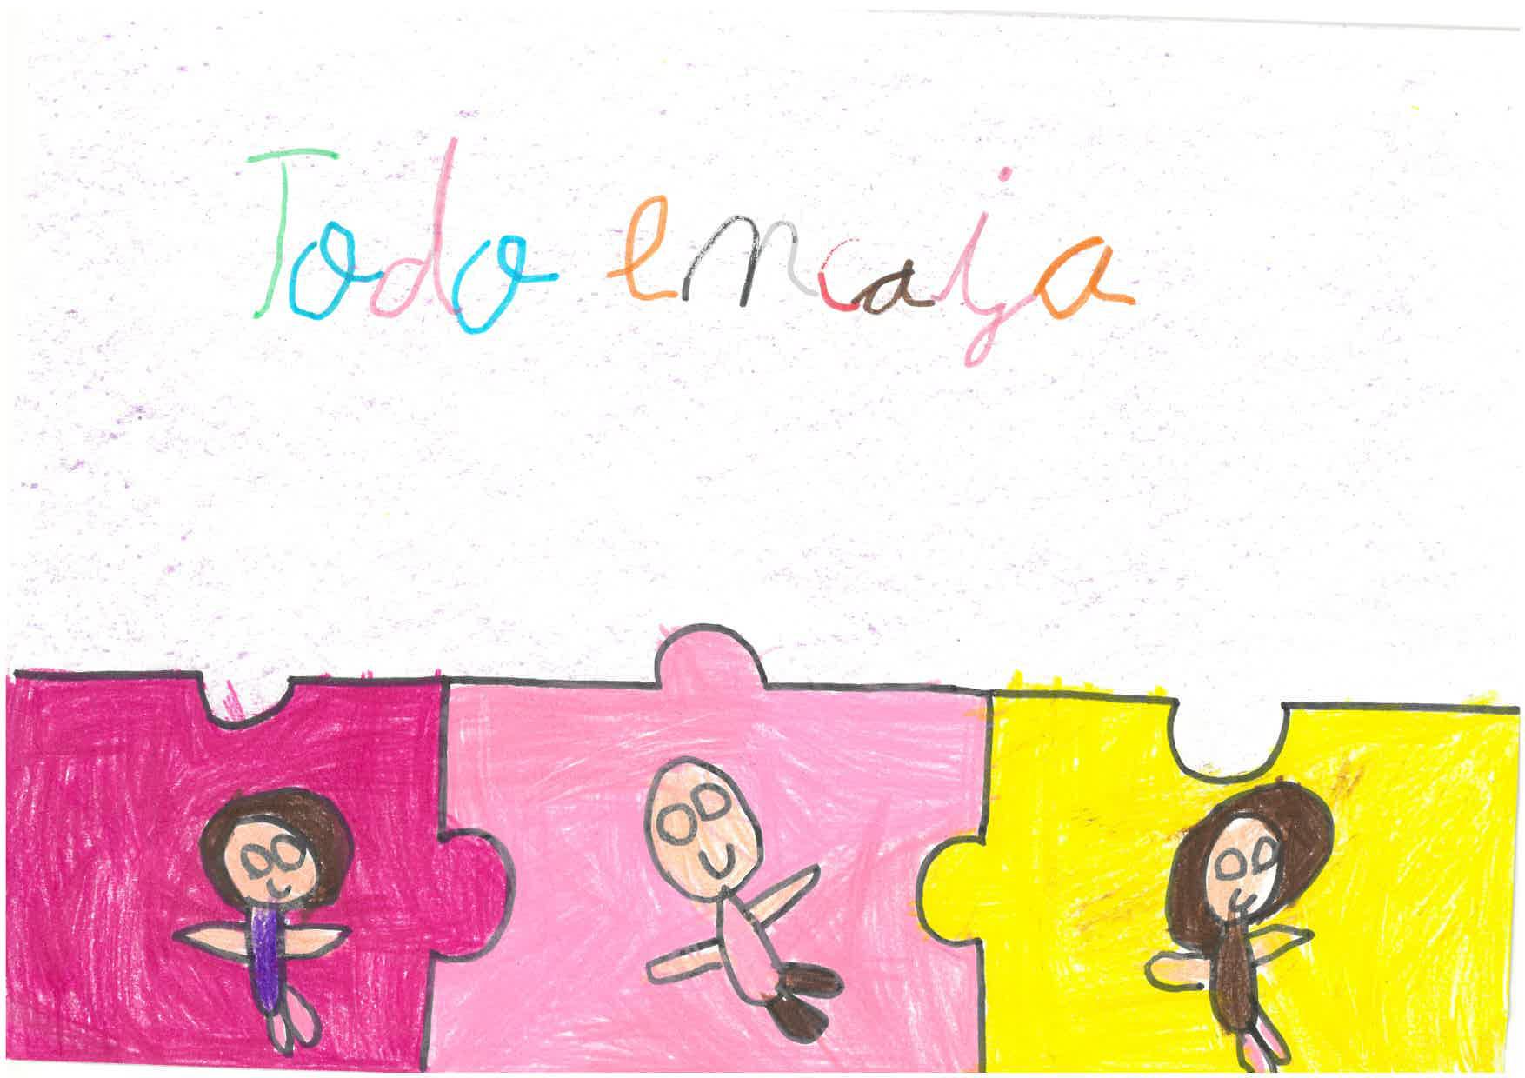
MARTA

Slide 14
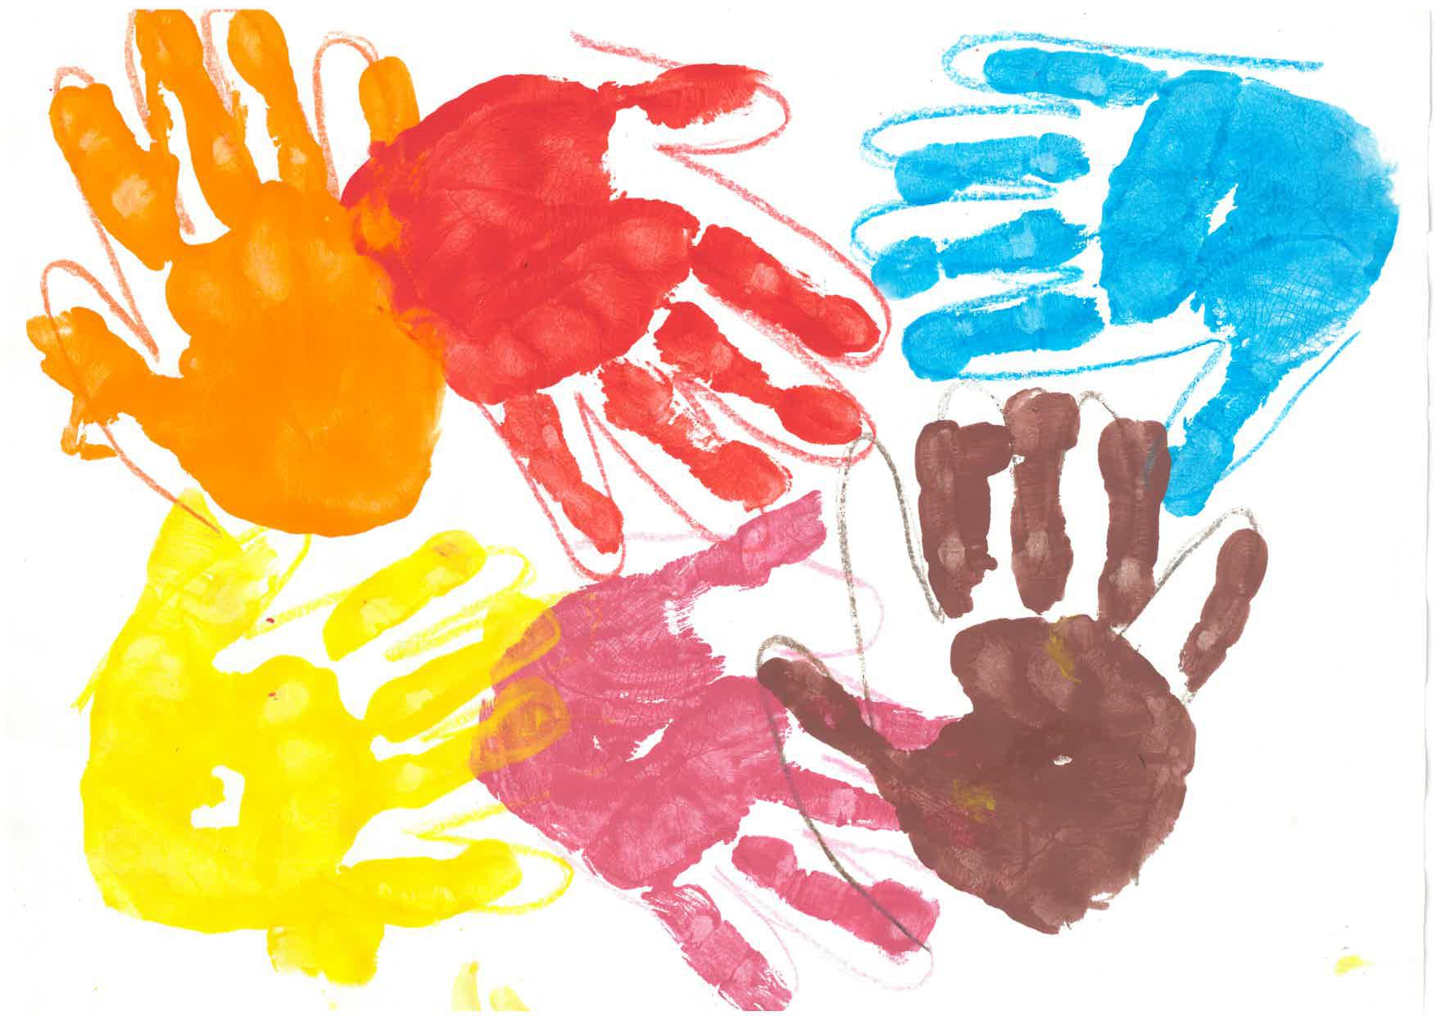
NEYZAN

Slide 15
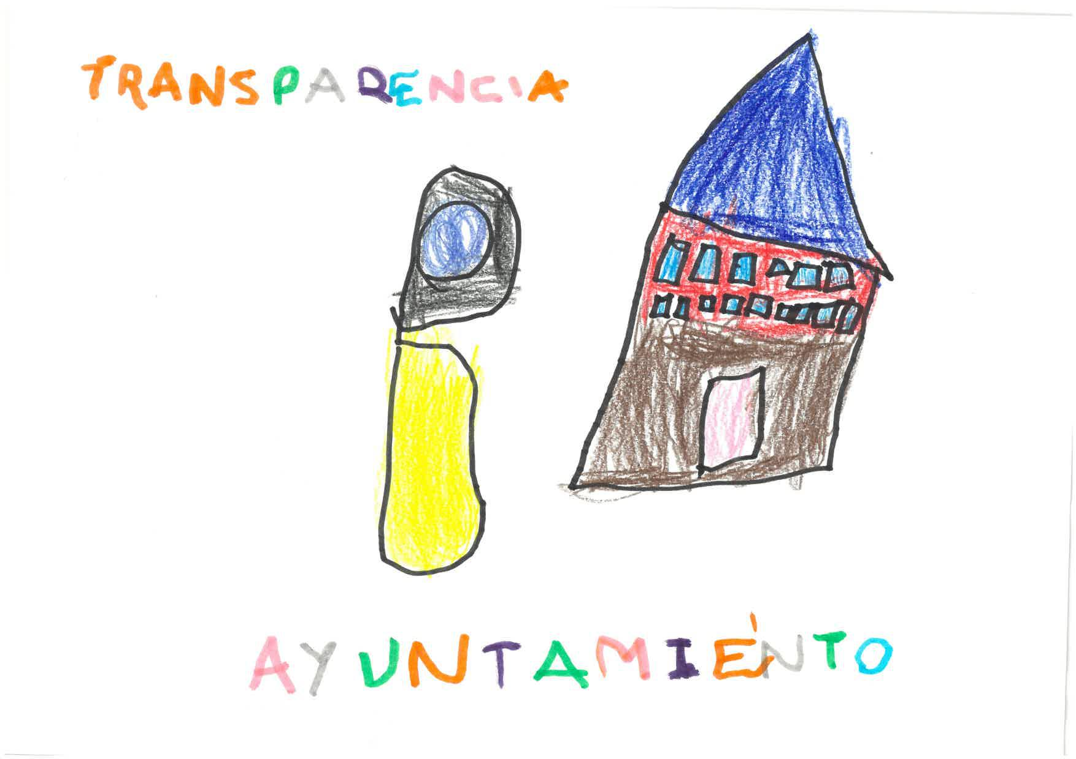
SAMUEL

Slide 16
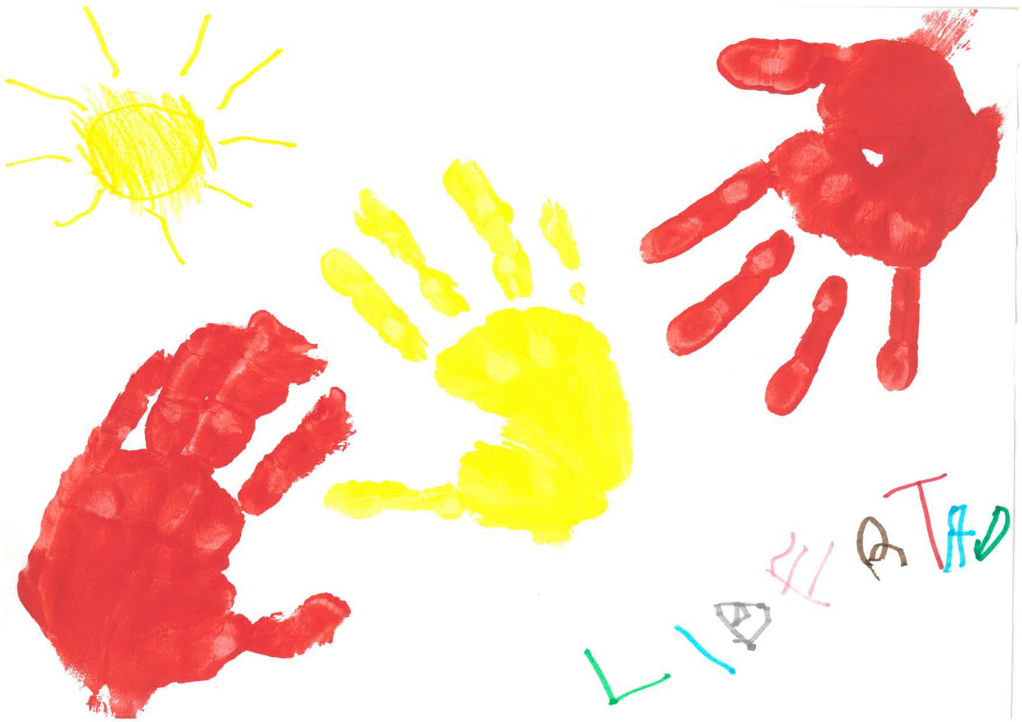
OLIVIA

Slide 17
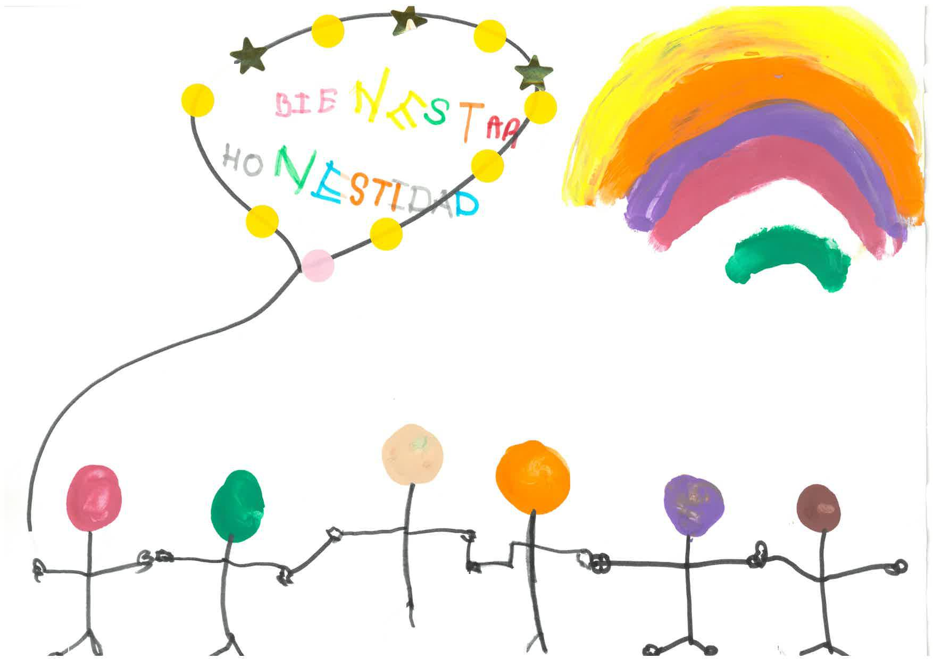
YAZIDE

Slide 18
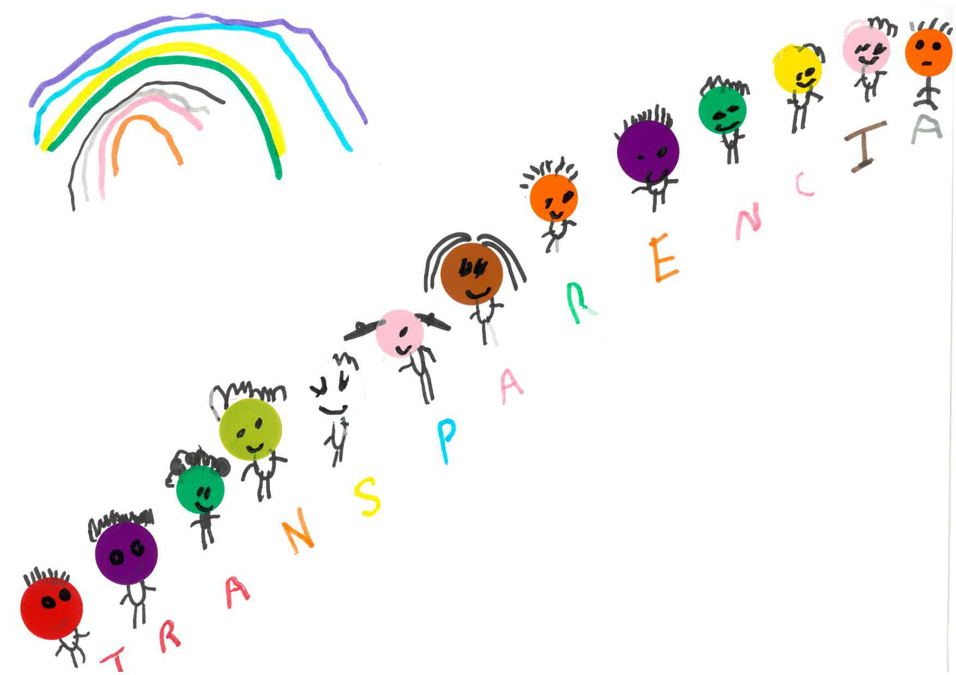
ZIYADE

Slide 19
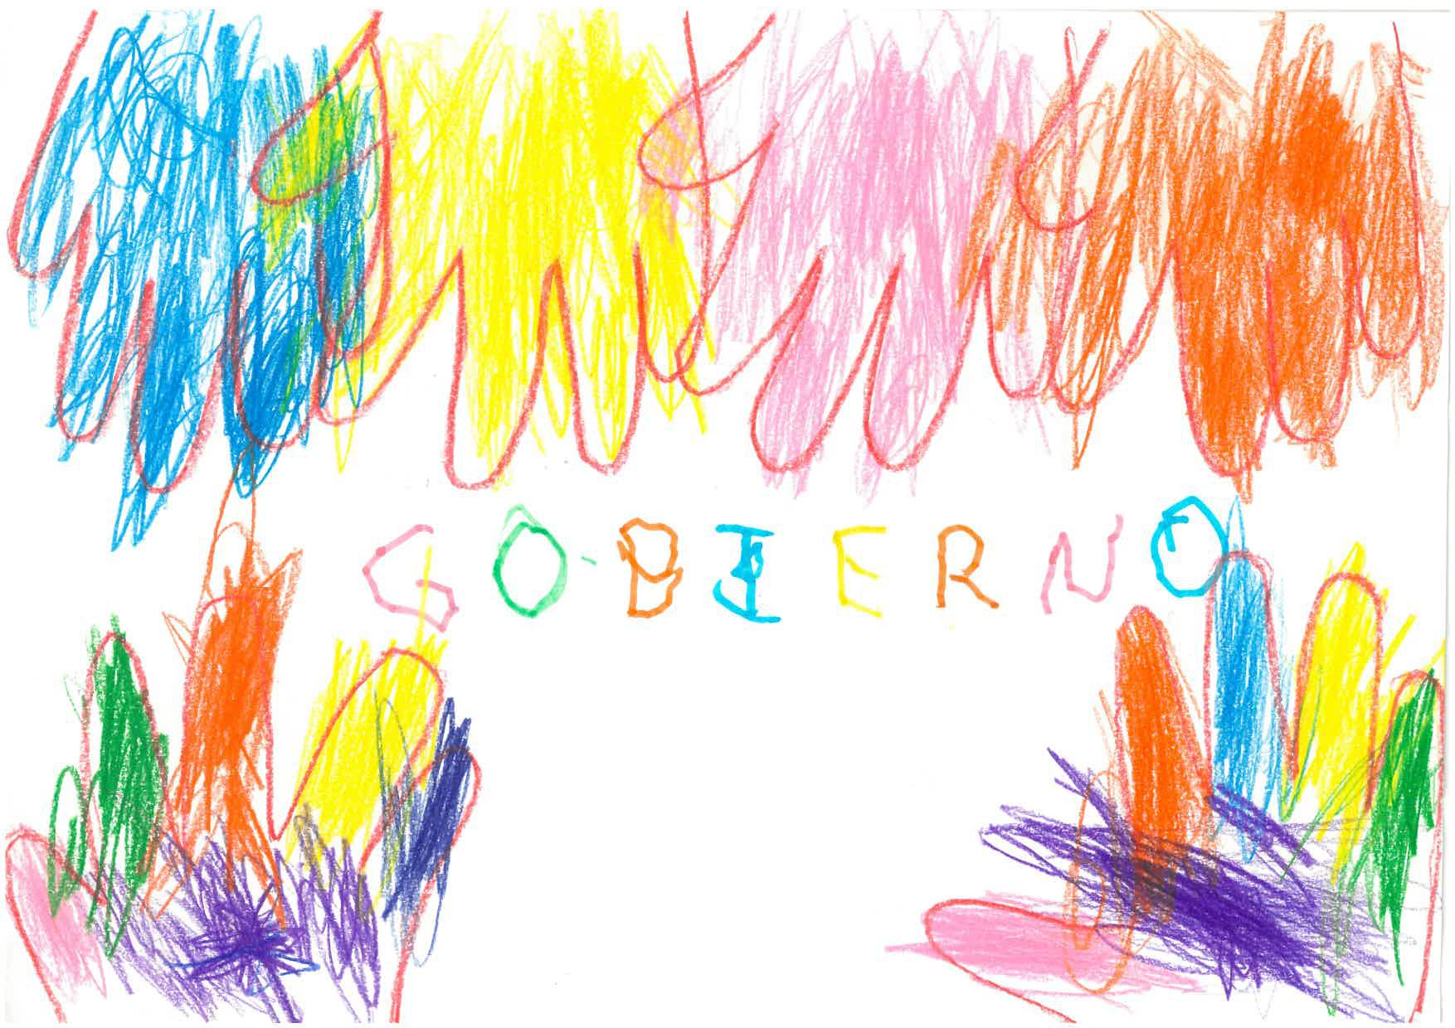
SUHAILA

Slide 20
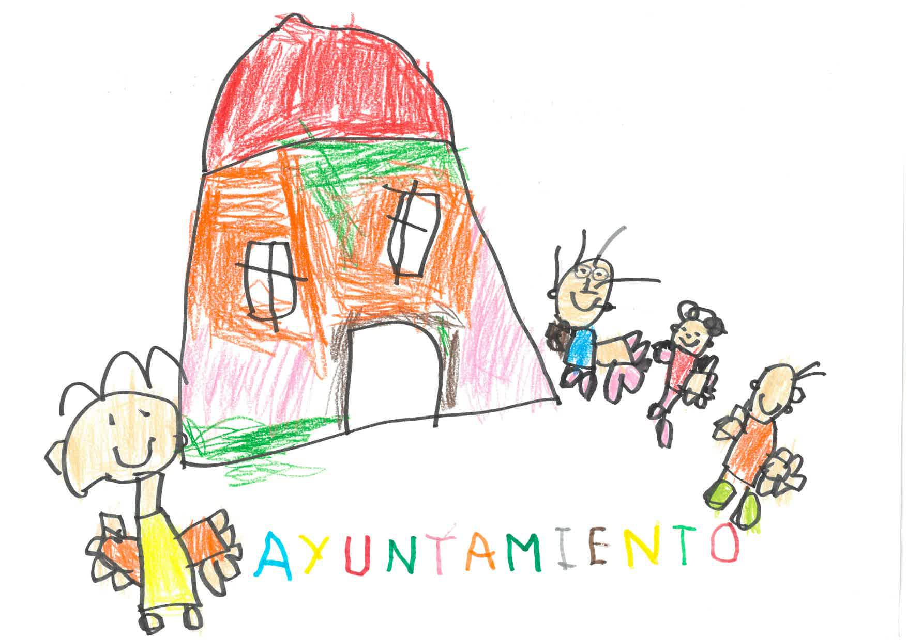
DYLAN

Slide 21
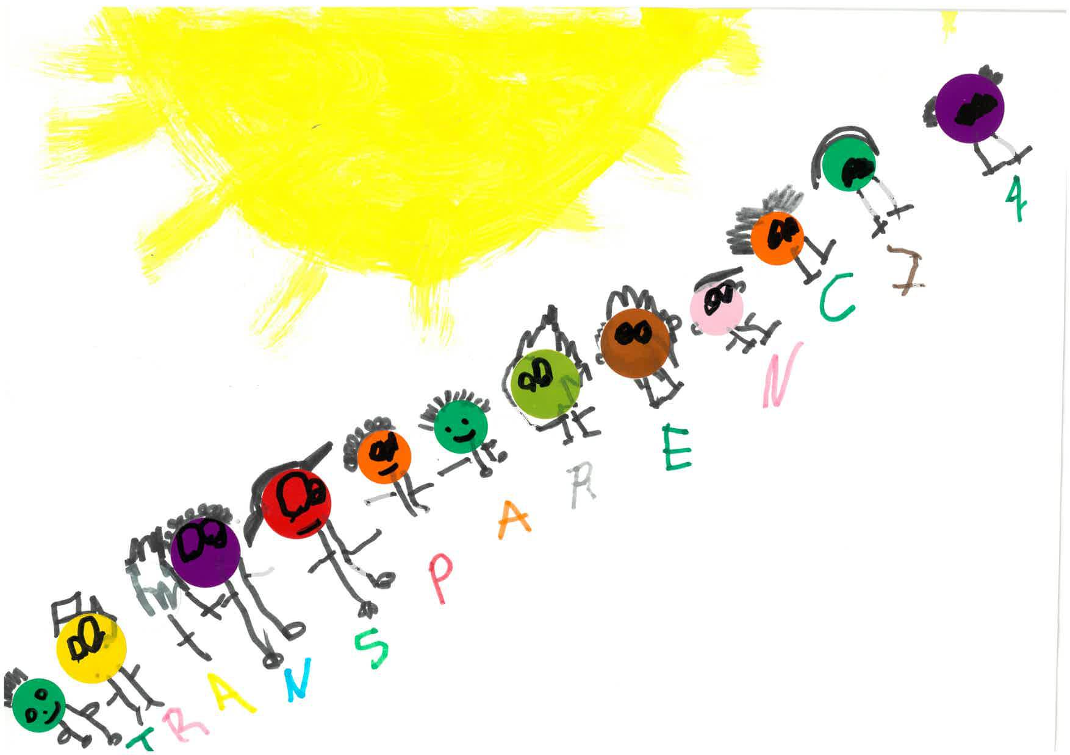
JUAN FRANCISCO

Slide 22
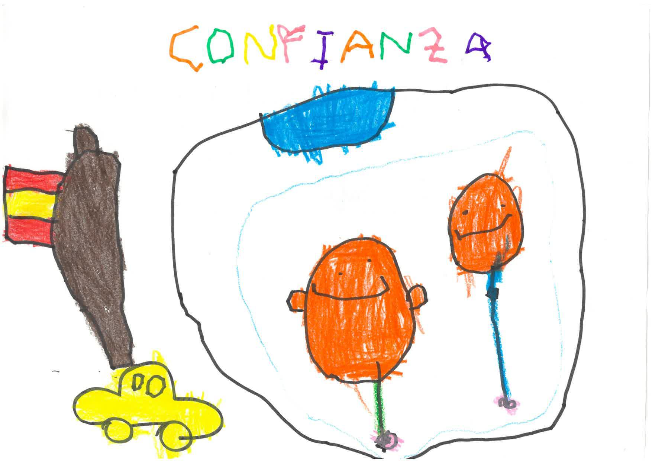
JORGE

Slide 23
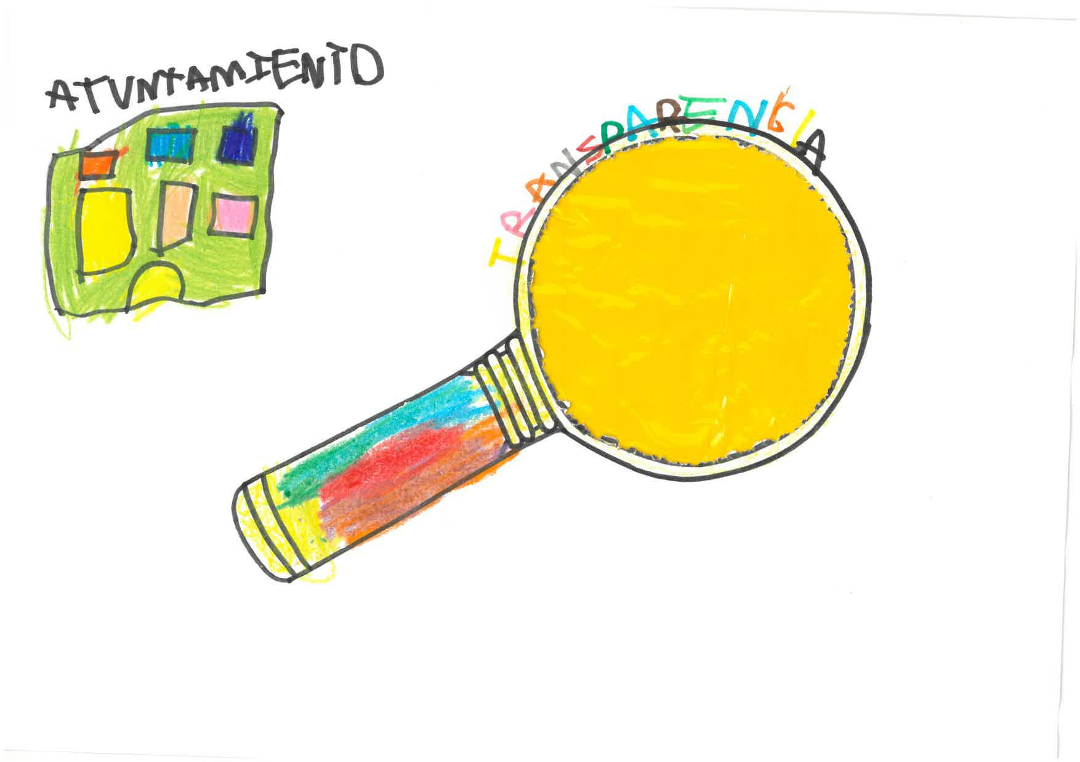
ELSA

